Slide 1
HOME AUTHORIZATION BASED AUTOMATIC SYSTEMS USING RASPBERRY PI WITH IOT
ADABALA SURESH 21JE1A0467

Slide 2
CONTENTS
INTRODUCTION TO HOME AUTOMATION
UNDERSTANDING RASPBERRY PI
IoT IN HOME AUTOMATION
HARDWARE COMPONENTS
WORKING METHODOLOGY
ADVANTAGES AND LIMITATIONS OF HOME AUTOMATION
FUTURE SCOPE

Slide 3
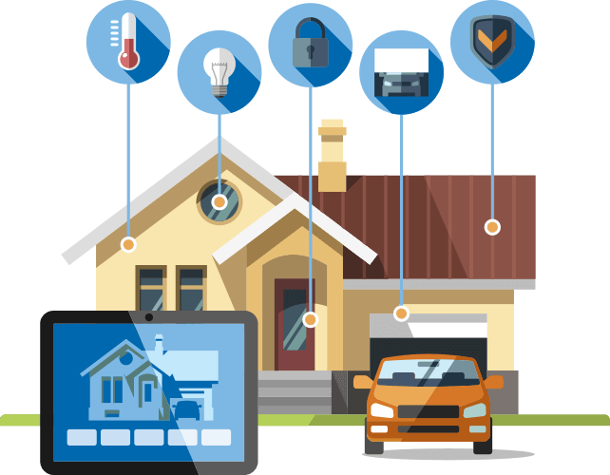
INTRODUCTION TO HOME AUTOMATION :
Home automation refers to the use of technology to control and manage various household systems and devices, such as lighting, heating, cooling, security, entertainment, and appliances, through the internet or other centralized systems.
Like locking doors remotely, or controlling lights and appliances with voice commands.

Slide 4
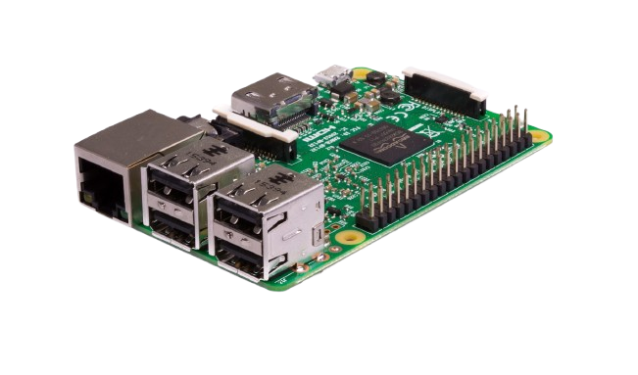
UNDERSTANDING RASPBERRY PI :
Raspberry Pi is a small, affordable, single-board computer developed by the Raspberry Pi Foundation, a UK-based charity.
Raspberry Pi is commonly used for educational purposes, DIY electronics, robotics, home automation, and Internet of Things (IoT) projects, due to its versatility, low cost, and support for various programming languages.

Slide 5
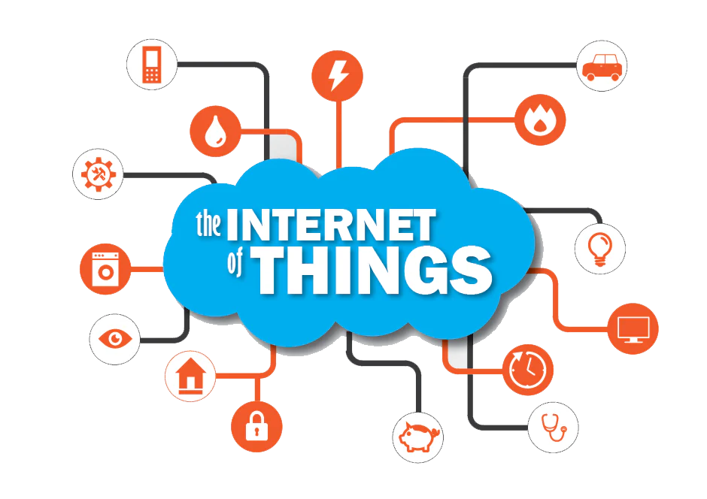
Iot in home automation :
IoT (Internet of Things) refers to the network of physical objects or "things" that are embedded with sensors, software, and other technologies, allowing them to connect and exchange data with other devices or systems over the internet.
Examples of IoT application include:
Smart homes
Healthcare
Industry

Slide 6
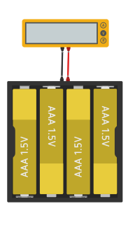

Hardware Components :
Components are used in Home Automation :
Raspberry pi 3
Power Supply
LED (Light Emitting Diode)
Face Camera
Relays

Slide 7
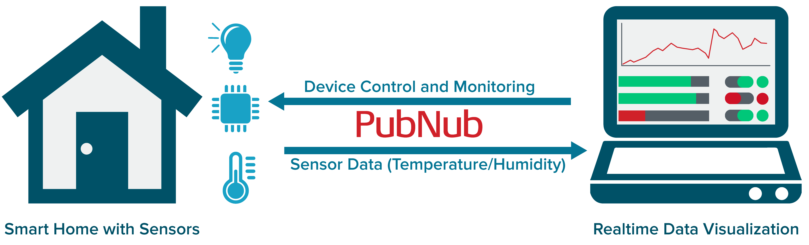
Working methodology :
The working methodology of Home Authorization Based Automatic Systems using Raspberry Pi with IoT involves the integration of various hardware and software components to create an intelligent home automation system that provides access control, security, and automation based on user authentication.
System Initialization and Setup
User Registration and Authentication Setup
Authentication Process (Access Control)
Remote Monitoring and Control
Security and Data Protection
System Maintenance and Updates

Slide 8

Advantages and limitations of home automation :
Advantages are :
Time and Energy can be saved.
Whole control of will be in under control.
Customization and Personalization.
Limitations are :
Cost of whole setup is very high.
Data can be stolen and home can be control by unknown person.
Dependence on Internet Connectivity.

Slide 9
Future Scope :
The future of home authorization-based automatic systems using Raspberry Pi and IoT is bright, with numerous opportunities for innovation.
he evolution of technologies like AI, machine learning, 5G connectivity, and advanced security protocols will allow for smarter, more secure, and energy-efficient homes.
As the Internet of Things becomes more integrated into everyday life, Raspberry Pi will continue to play a pivotal role in the development of low-cost, customizable, and flexible home automation solutions.

Slide 10
THANK YOU

